Slide 1
System Development Plan
Presenter: Henry Ho
Author: Henry Ho

Slide 2
Project Scope
Project Objective
Project Specifics
Project SDP
Approval Process
New Business Model
Additional Revenue Stream
Online Presence
New Client onboarding
Web Application
Account Creation
Self-Service portal
Fully functional Website
Prince2 Model
Easy to manage phases
Front & Back-end team
Minimize risks
Weekly Client Meeting
Approve or Deny work
Adapt changes
Prepare for the next meeting

Slide 3
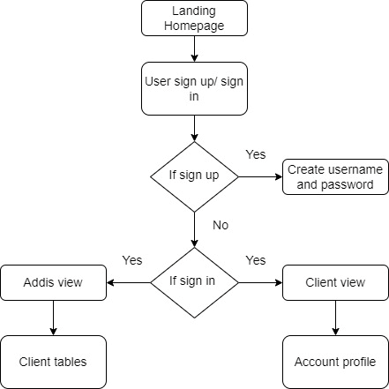
Project Requirement
Project Features
Accessibility
Improve Customer Engagement
Operating Environment
Windows
Design and Constraints
Budget
Timespan
Assumption and Dependencies
Regulatory Requirements
Previous Course and Project Adaption
New Business Model
Linux
Technical Expertise

Slide 4
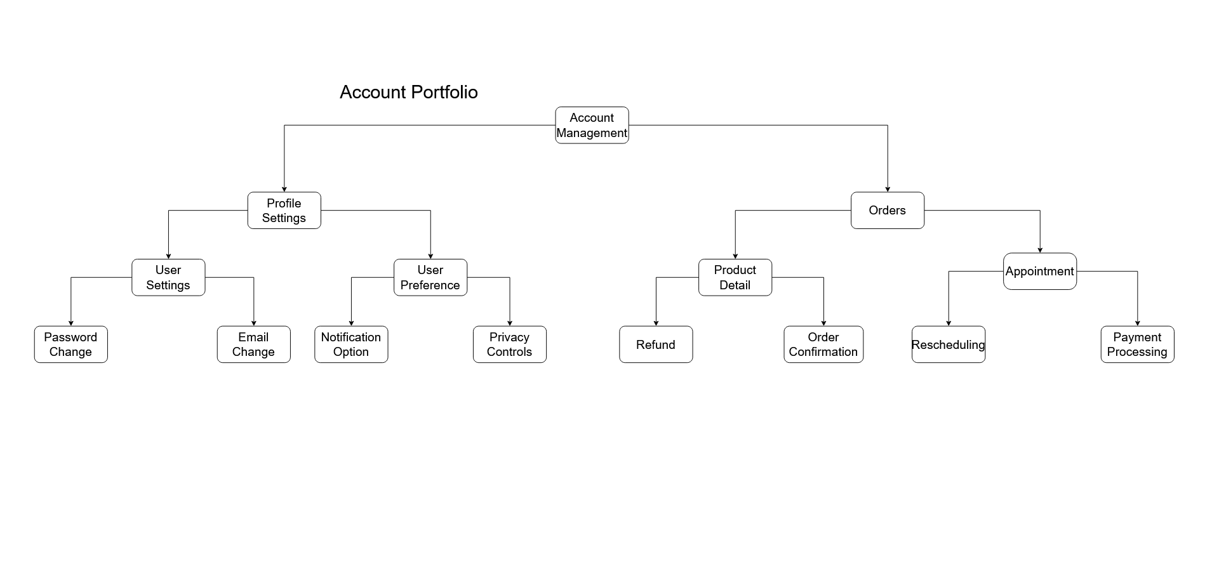
System Features

Slide 5
Non-functional Requirements
Usability
Website must be Ease-of-Use
Recoverability
Incidents will be matched with steps to achieve fully functional status
Performance
Handle multiple requests, web traffic
Security
Protect user data, assign proper authorization
Reliability
No down-time, reliable whenever customer needs

